Slide 1


Object Oriented
Software Engineering
John Andrews

Slide 2

Sequence diagrams

Slide 3
UML Sequence Diagrams
Describe the flow of messages, events, actions between objects
Show concurrent processes and activations
Show time sequences that are not easily depicted in other diagrams
Typically used during analysis and design to document and understand the logical flow of your system
Emphasis on time ordering!

Slide 4
Sequence diagram example
Client
ATM-Machine
SavingAccount
Insert ATM card
Request PIN
Enter PIN code
Verify PIN code
PIN valid
Request amount
Enter amount
Process transaction
Transaction successful
Dispense cash
Print receipt

Slide 5
Sequence Diagram (make a phone call)
Caller
Phone
Recipient
Picks up
Dial tone
Dial
Ring
Ring notification
Picks up
Hello
Hello

Slide 6
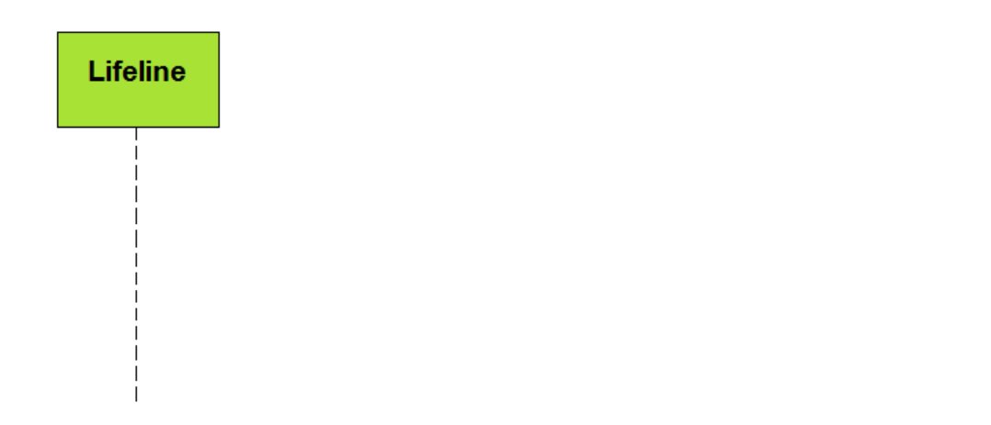
Lifeline
A lifeline represents a participant in the sequence diagram and is located at the top.

Slide 7
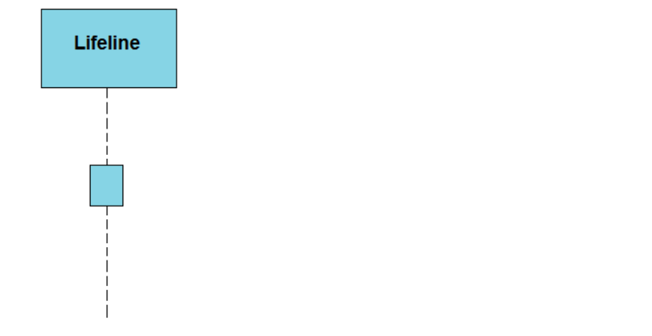
Activation
Represents the time needed for an object to complete a task. The longer the task will take, the longer the activation box becomes. So both the edges (top and bottom) can be associated with the initiation time and completion time, respectively.

Slide 8
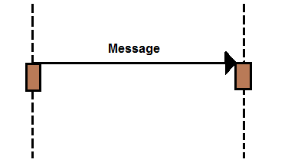
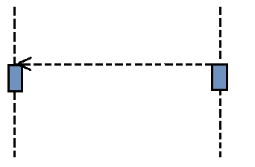
Messages
Call Message: Call message describes the communication among the interaction’s lifeline, which illustrates that an objective lifeline has conjured an operation.
Return Message: Return message describes a specific communication among the interaction’s lifeline that illustrates the information flow from the assignee of the caller message.

Slide 9
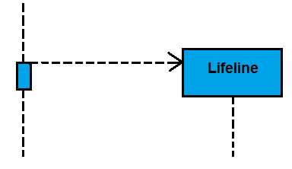
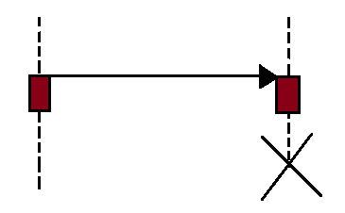
Messages
Destroy Message: Destroy message defines a conversation for destroying the target’s lifecycle.
Create Message: Particularly, it defines a communication depicting that an object lifeline has been instantiated.

Slide 10
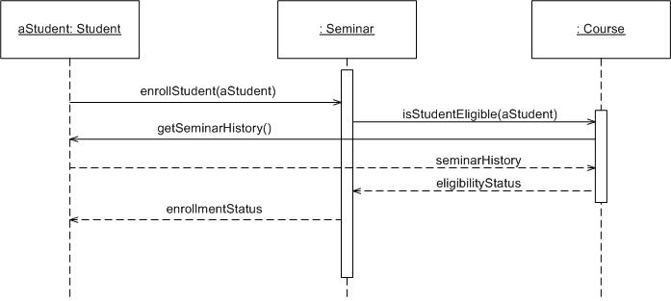
Sequence Diagram
Example:
Time Increasing -->
All lines should be horizontal to indicate instantaneous actions. Additionally if ActivityA happens before ActivityB, ActivityA must be above activity A

Slide 11
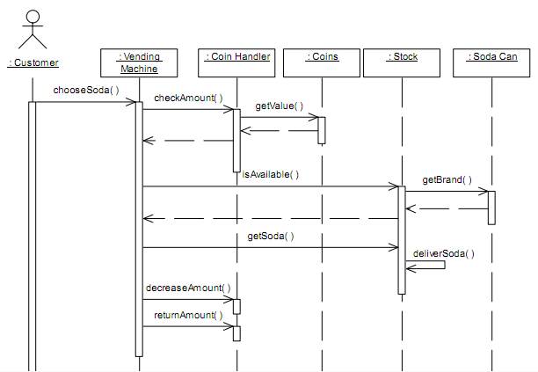
Examples:
Part of a Vending Machine

Slide 12
Banking task: applying interest to a savings account
Points to note:
  Sequence diagrams are time-ordered
  Actual arguments can include literals or references to participating objects
driver
: Customer
: SavingsAccount
balance :
Money
accounts( )
applyInterest( )
multiply( 0.08 )
create( )
interest :
Money
interest
add( interest )
create( )
newBalance :
Money
newBalance
create( Transaction.INTEREST, interest, this )
: Transaction

Slide 13
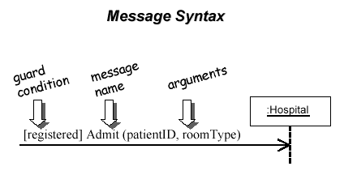
Messages Between Objects
messages (method calls) indicated by arrow to other object
  write message name and arguments above arrow

Slide 14
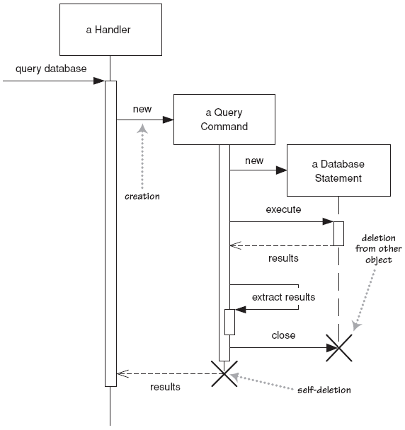
Lifetime of objects
creation: arrow with 'new' written above it
  notice that an object created after the start of the scenario appears lower than the others
deletion: an X at bottom of object's lifeline

Slide 15
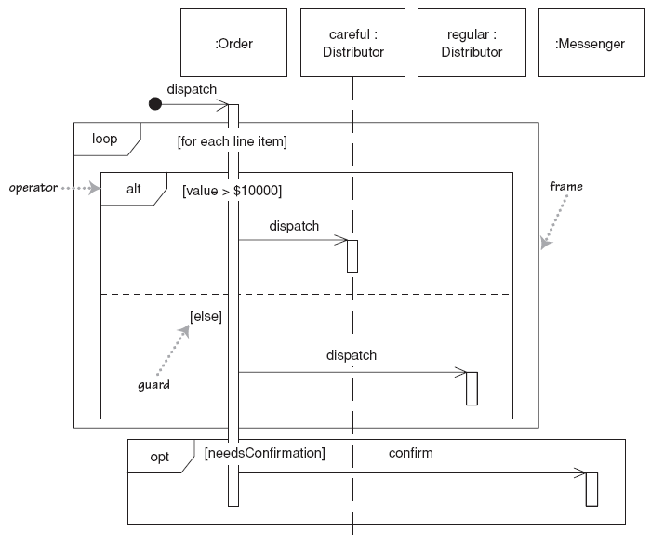
Selection and loops
frame: box around part of diagram to indicate if or loop
  if -> (opt) [condition]
  if/else -> (alt) [condition], separated by horizontal dashed line
  loop -> (loop) [condition or items to loop over]

Slide 16
Why not just code it?
Sequence diagrams can be somewhat close to the code level.
So why not just code up that algorithm rather than drawing it as a sequence diagram?
  a good sequence diagram is still a bit above the level of the real code (not all code is drawn on diagram)
  sequence diagrams are language-agnostic (can be implemented in many different languages
  non-coders can do sequence diagrams
  easier to do sequence diagrams as a team
  can see many objects/classes at a time on same page (visual bandwidth)

Slide 17
Appendix

Slide 18
Sequence diagram
sd Add a new advert to a campaign
Interaction Constraint
Frame label
:CampaignManager
:Client
:Campaign
:Advert
getName
Interaction Operator
listCampaigns
Combined Fragment
(loop)
loop
[For all client’s campaigns]
getCampaignDetails
Sequence diagram
is enclosed in a
frame
listAdverts
loop
[For all campaign’s adverts]
getAdvertDetails
addNewAdvert
Advert
newAd:Advert
Lifeline
Activation or Execution
Object creation

Slide 19
sd Add a new advert to a campaign if within budget
:CampaignManager
:Client
:Campaign
:Advert
getName
listCampaigns
ref
List client campaigns
ref
Get campaign budget
addCostedAdvert
alt
[totalCost <= budget]
alt interaction operator
shows branching
Advert
newAd:Advert
[else]
newRequest:Request
Request
Two interaction operands,
one for each alternative
Notes:
19

Slide 20
Sequence diagram example (cont.)
sd Add a new advert to a campaign
Interaction Constraint
Frame label
:CampaignManager
:Client
:Campaign
:Advert
getName
Interaction Operator
listCampaigns
Combined Fragment
(loop)
loop
[For all client’s campaigns]
getCampaignDetails
A sequence diagram
is enclosed in a
frame
listAdverts
loop
[For all campaign’s adverts]
getAdvertDetails
addNewAdvert
Advert
newAd:Advert
Lifeline
Activation or Execution
Object creation
Notes:
20

Slide 21
50% Project Part 1
due on Week 6

Slide 22
Project action
Please review Part 1 of the project guidelines and consider if you would like to work in a team of 2 or 3 (max 3 people per team)—you may coordinate now to team up.
Then consider your designated option per the last digit of student ID or if you would like to work on a business domain familiar to one of you.

